Slide 1
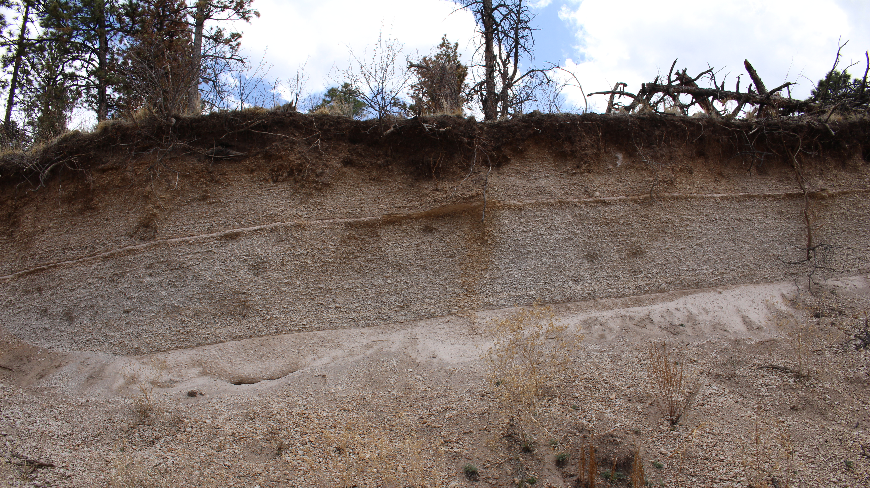

Post-Caldera Explosive Eruptions at the Valles Caldera, NM
Yamini Patel
Mentors: Amanda Clarke, Jacqueline Giblin
Arizona Space Grant Symposium
April 23rd, 2022

Slide 2
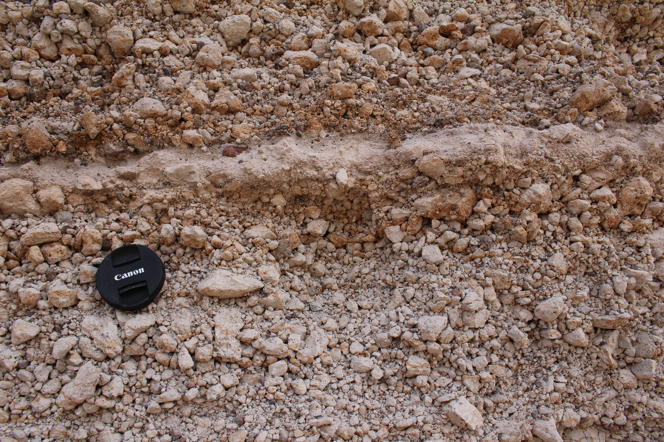

Background
‘Restless’ magmatic systems of calderas.
  Smaller eruptions
    Effusive lava domes
    Smaller scale pyroclastic deposits
Example
  Valles Caldera, NM
Most recent eruption was about 50,000 years ago.
  El Cajete pyroclastic deposits
Closeup of the El Cajete outcrop (camera lens for scale).

Slide 3
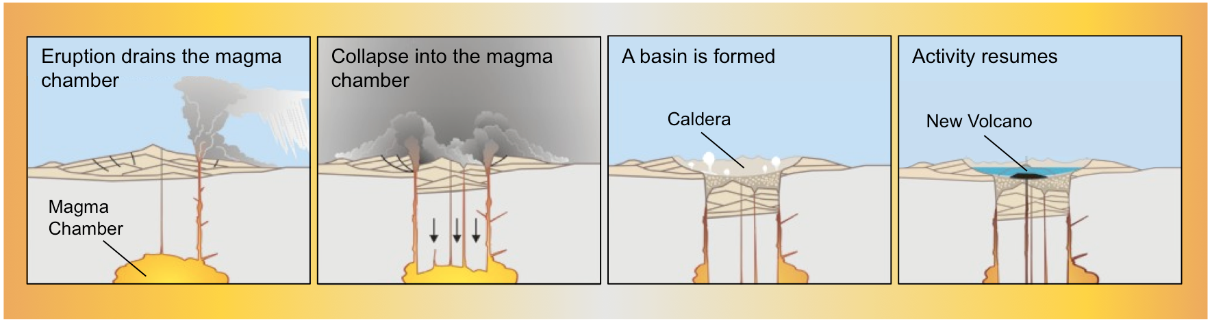
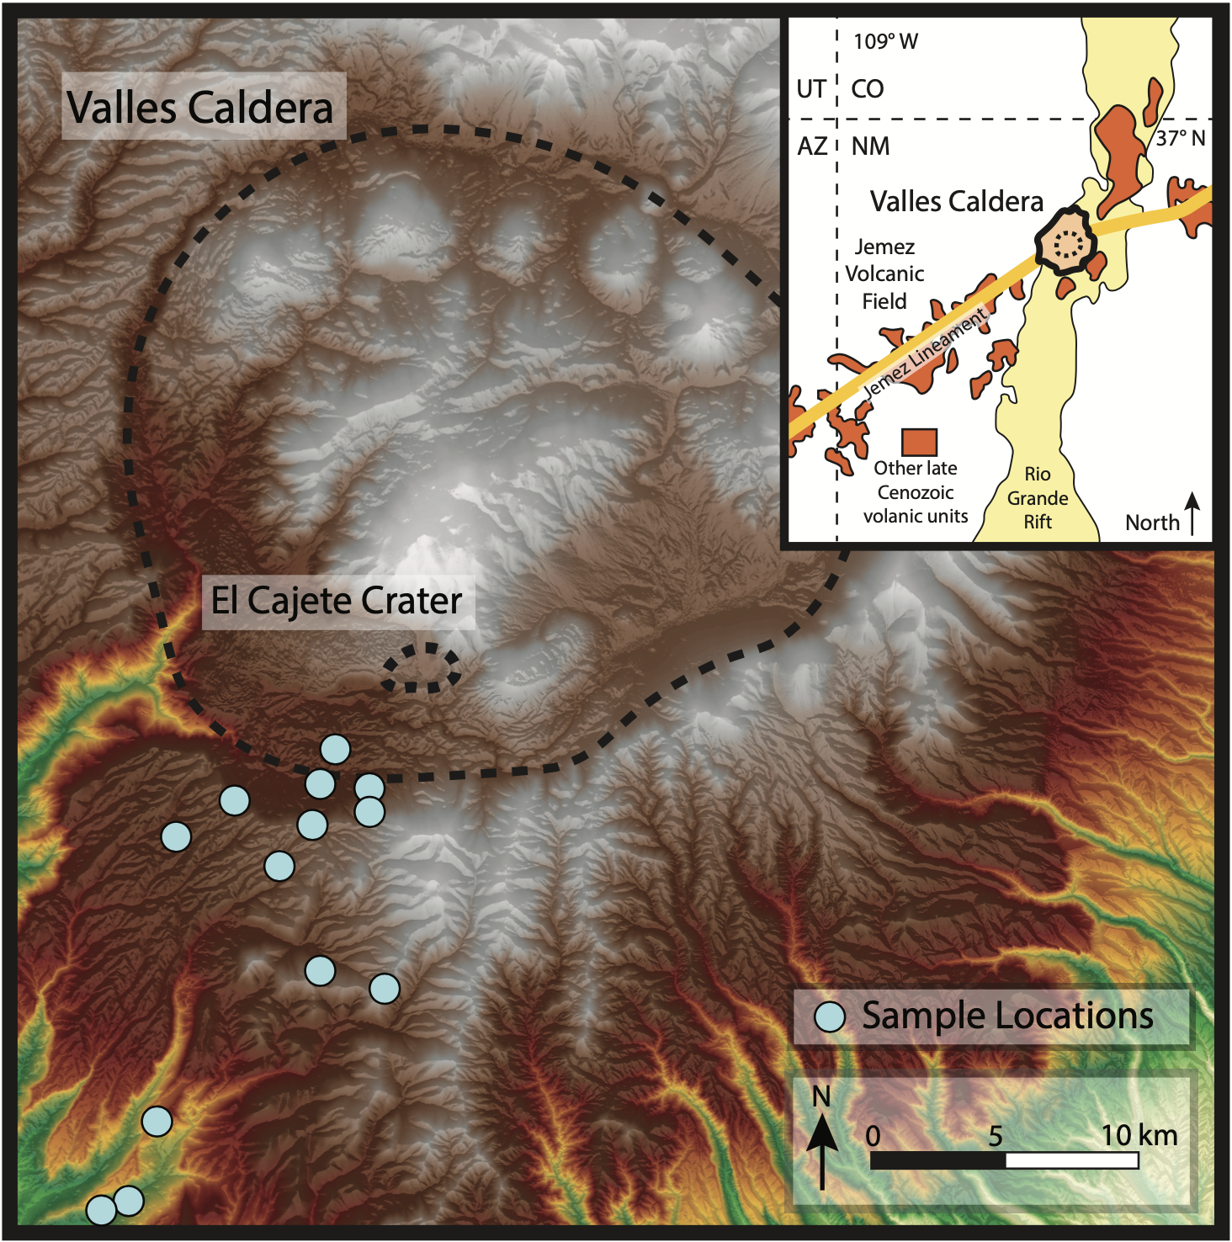
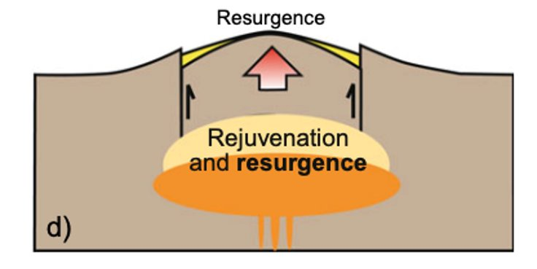
Digital elevation model (DEM) of Valles Caldera with sample locations.

Slide 4
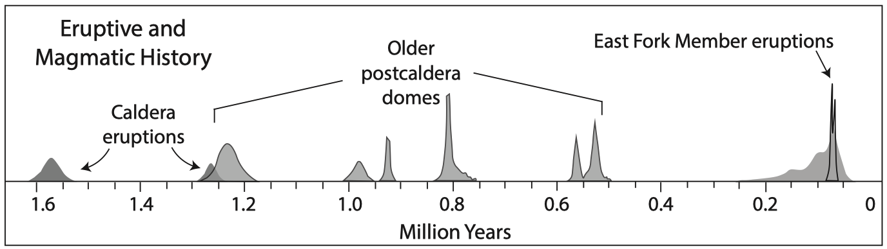
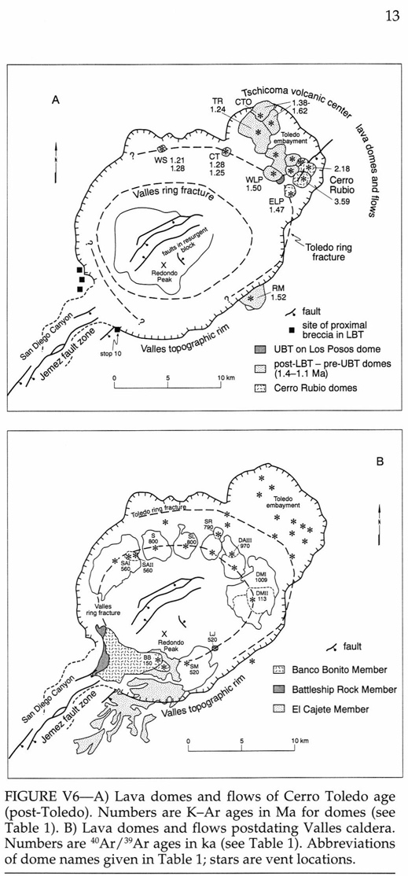

Modified from Self et al. 1996

Slide 5
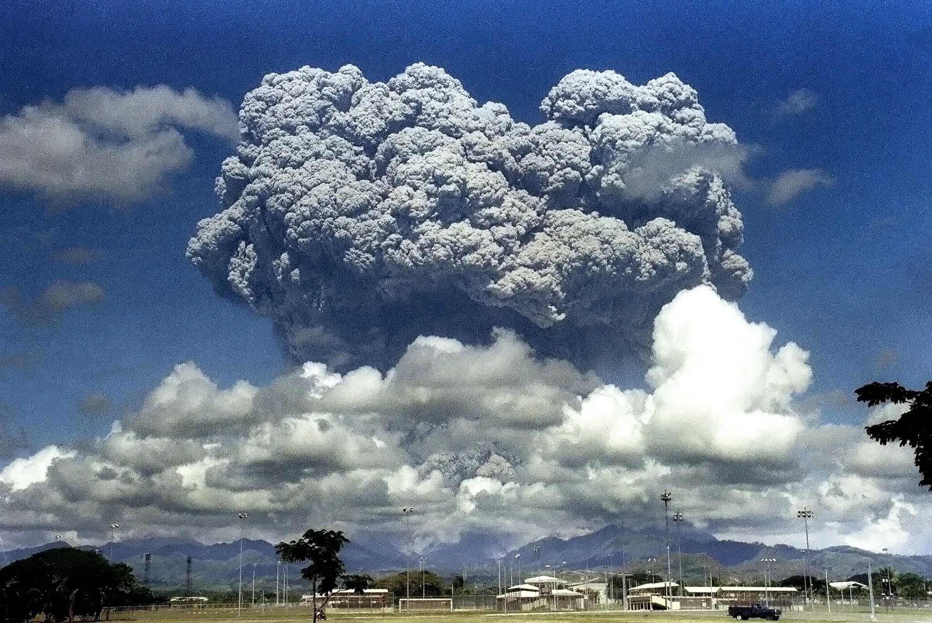
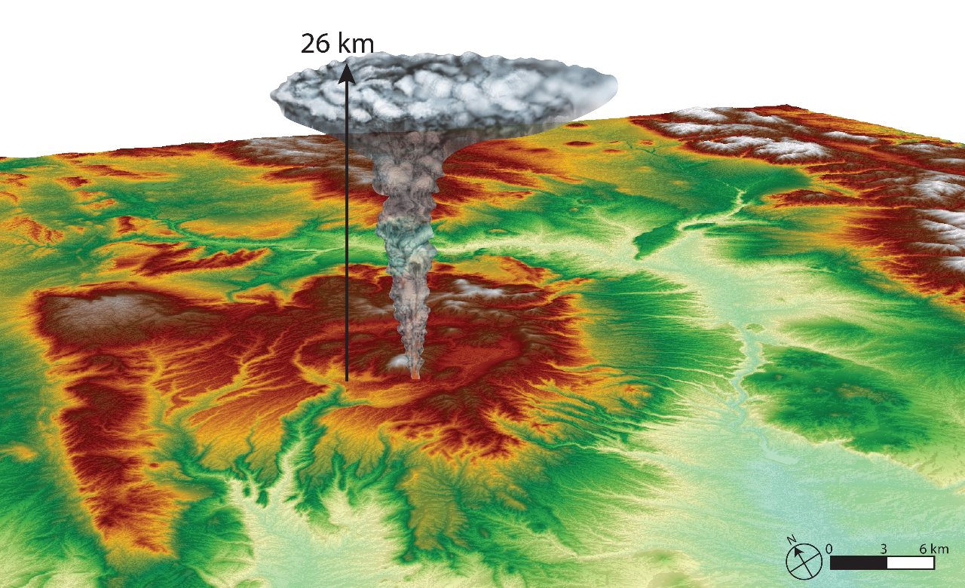
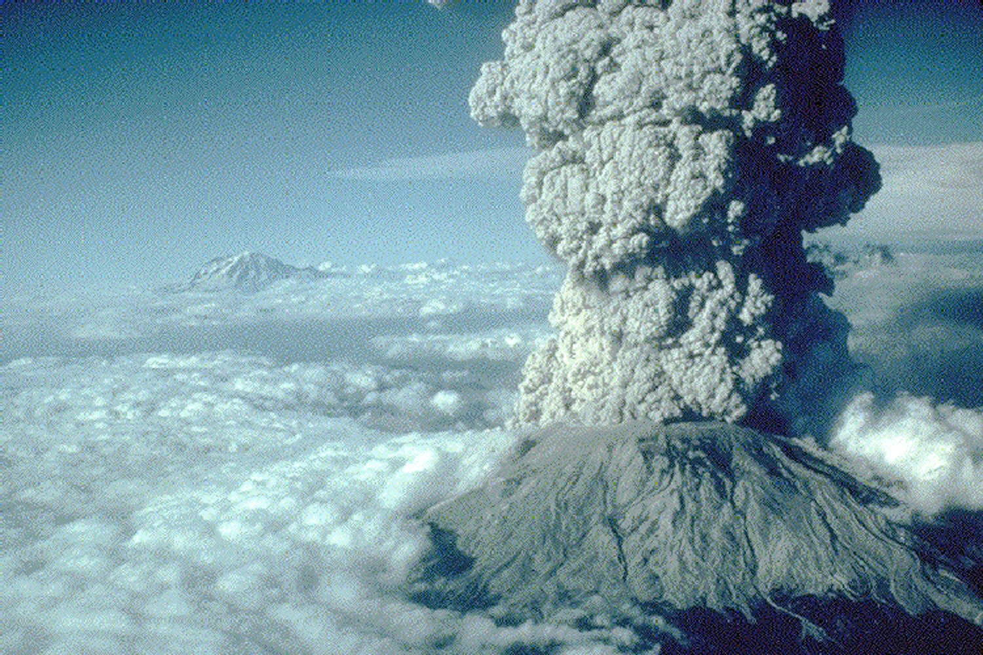
Eruption Characteristics from mapping of JLG
1991 Mt. Pinatubo
~35 km
Column Heights ~ 24 - 26 km
Volume ~ 0.5 - 1 km³
Getty Images
1980 Mt. St. Helens
~20 km
Methods
Bonadonna and Costa, 2012
Carey and Sparks, 1986
Notes:
Isopach maps illustrate the deposit thickness and volume was estimated by integrating isopach contours based on area. Isopleth contour maps reveal the distribution of maximum pumice and lithic clast sizes deposited from El Cajete crater, from which the column height was estimated by using a relationship of the distance clasts are transported from the source to the height of the volcanic plume. Preliminary estimates of the lower unit, reveal a column height of about 26 km and volume of about 1.4 cubic km.

Slide 6
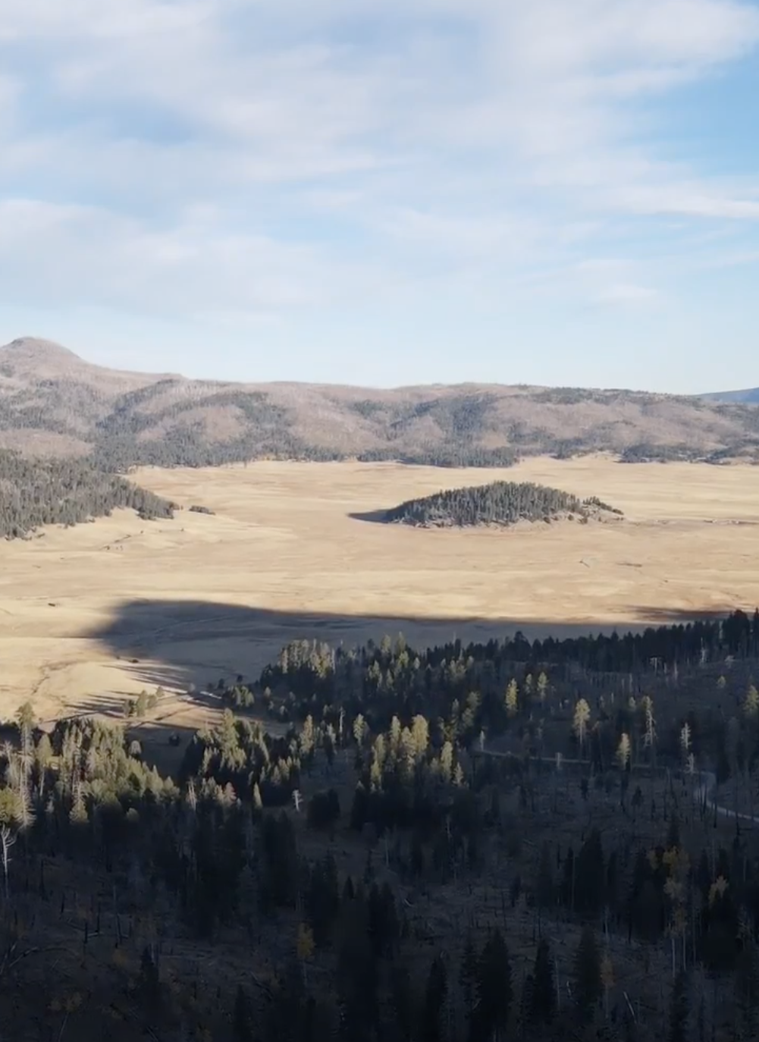
Purpose
Examine the textures of the El Cajete pumice to understand:
  Is there a new batch of magma beneath the caldera?
    Are the pumices petrographically and composition different from the caldera-forming pumice?
  Plumbing system dynamics that led to the youngest eruption

Slide 7
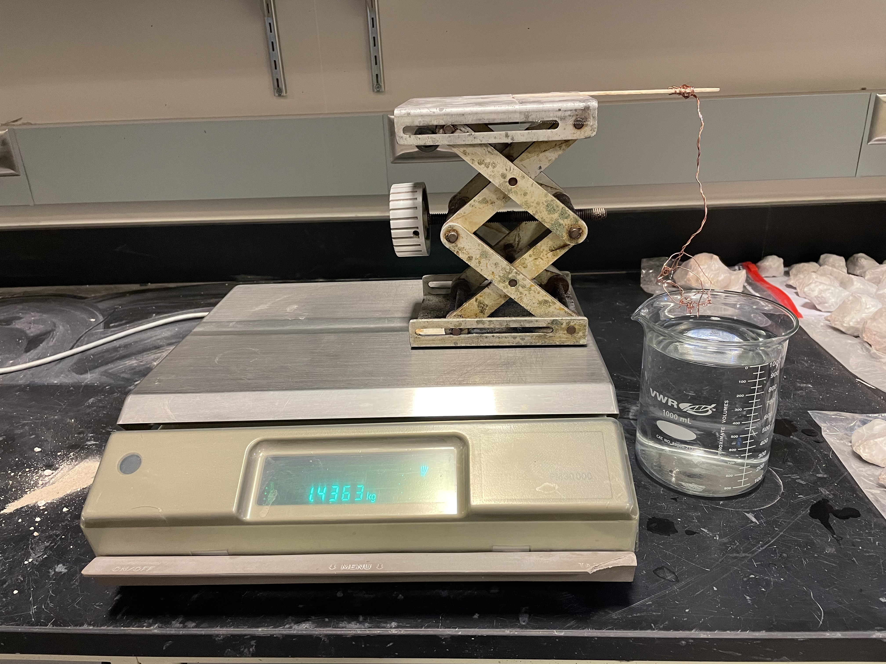

Methods
Clasts were dried and then wrapped in Parafilm.
Using the method of Houghton & Wilson (1989), clast densities were measured by weighing clasts in air and while suspended in distilled water.
The specific gravity of the clasts were calculated using Archimedes’s principle:
Specific gravity =
$\frac{\text{(}\text{Weight} \text{in} \text{air}\text{)}}{\text{(}\text{Weight} \text{in} \text{air}\text{ − }\text{Weight} \text{in} \text{water}\text{) }}$
Clast Density = Specific gravity × density

Slide 8
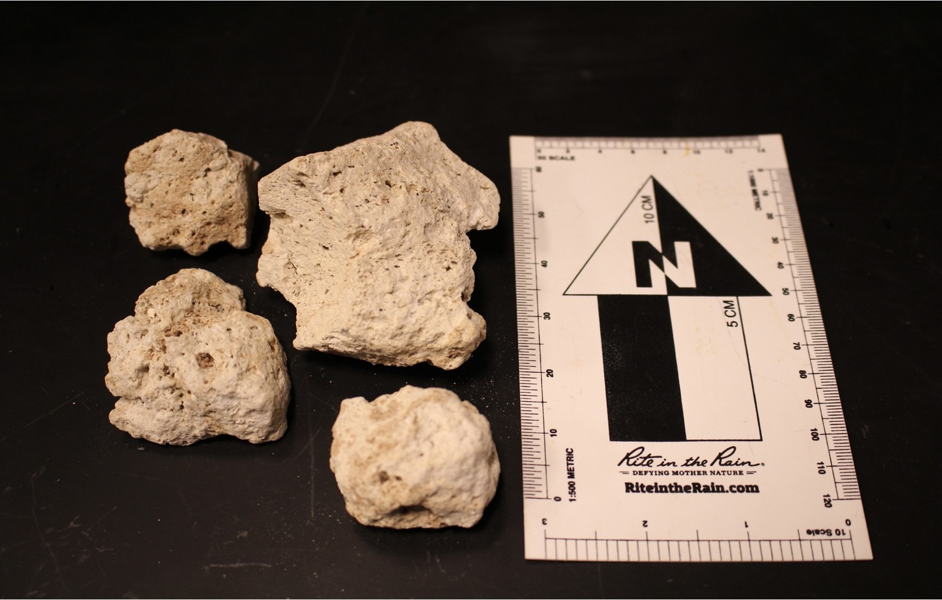
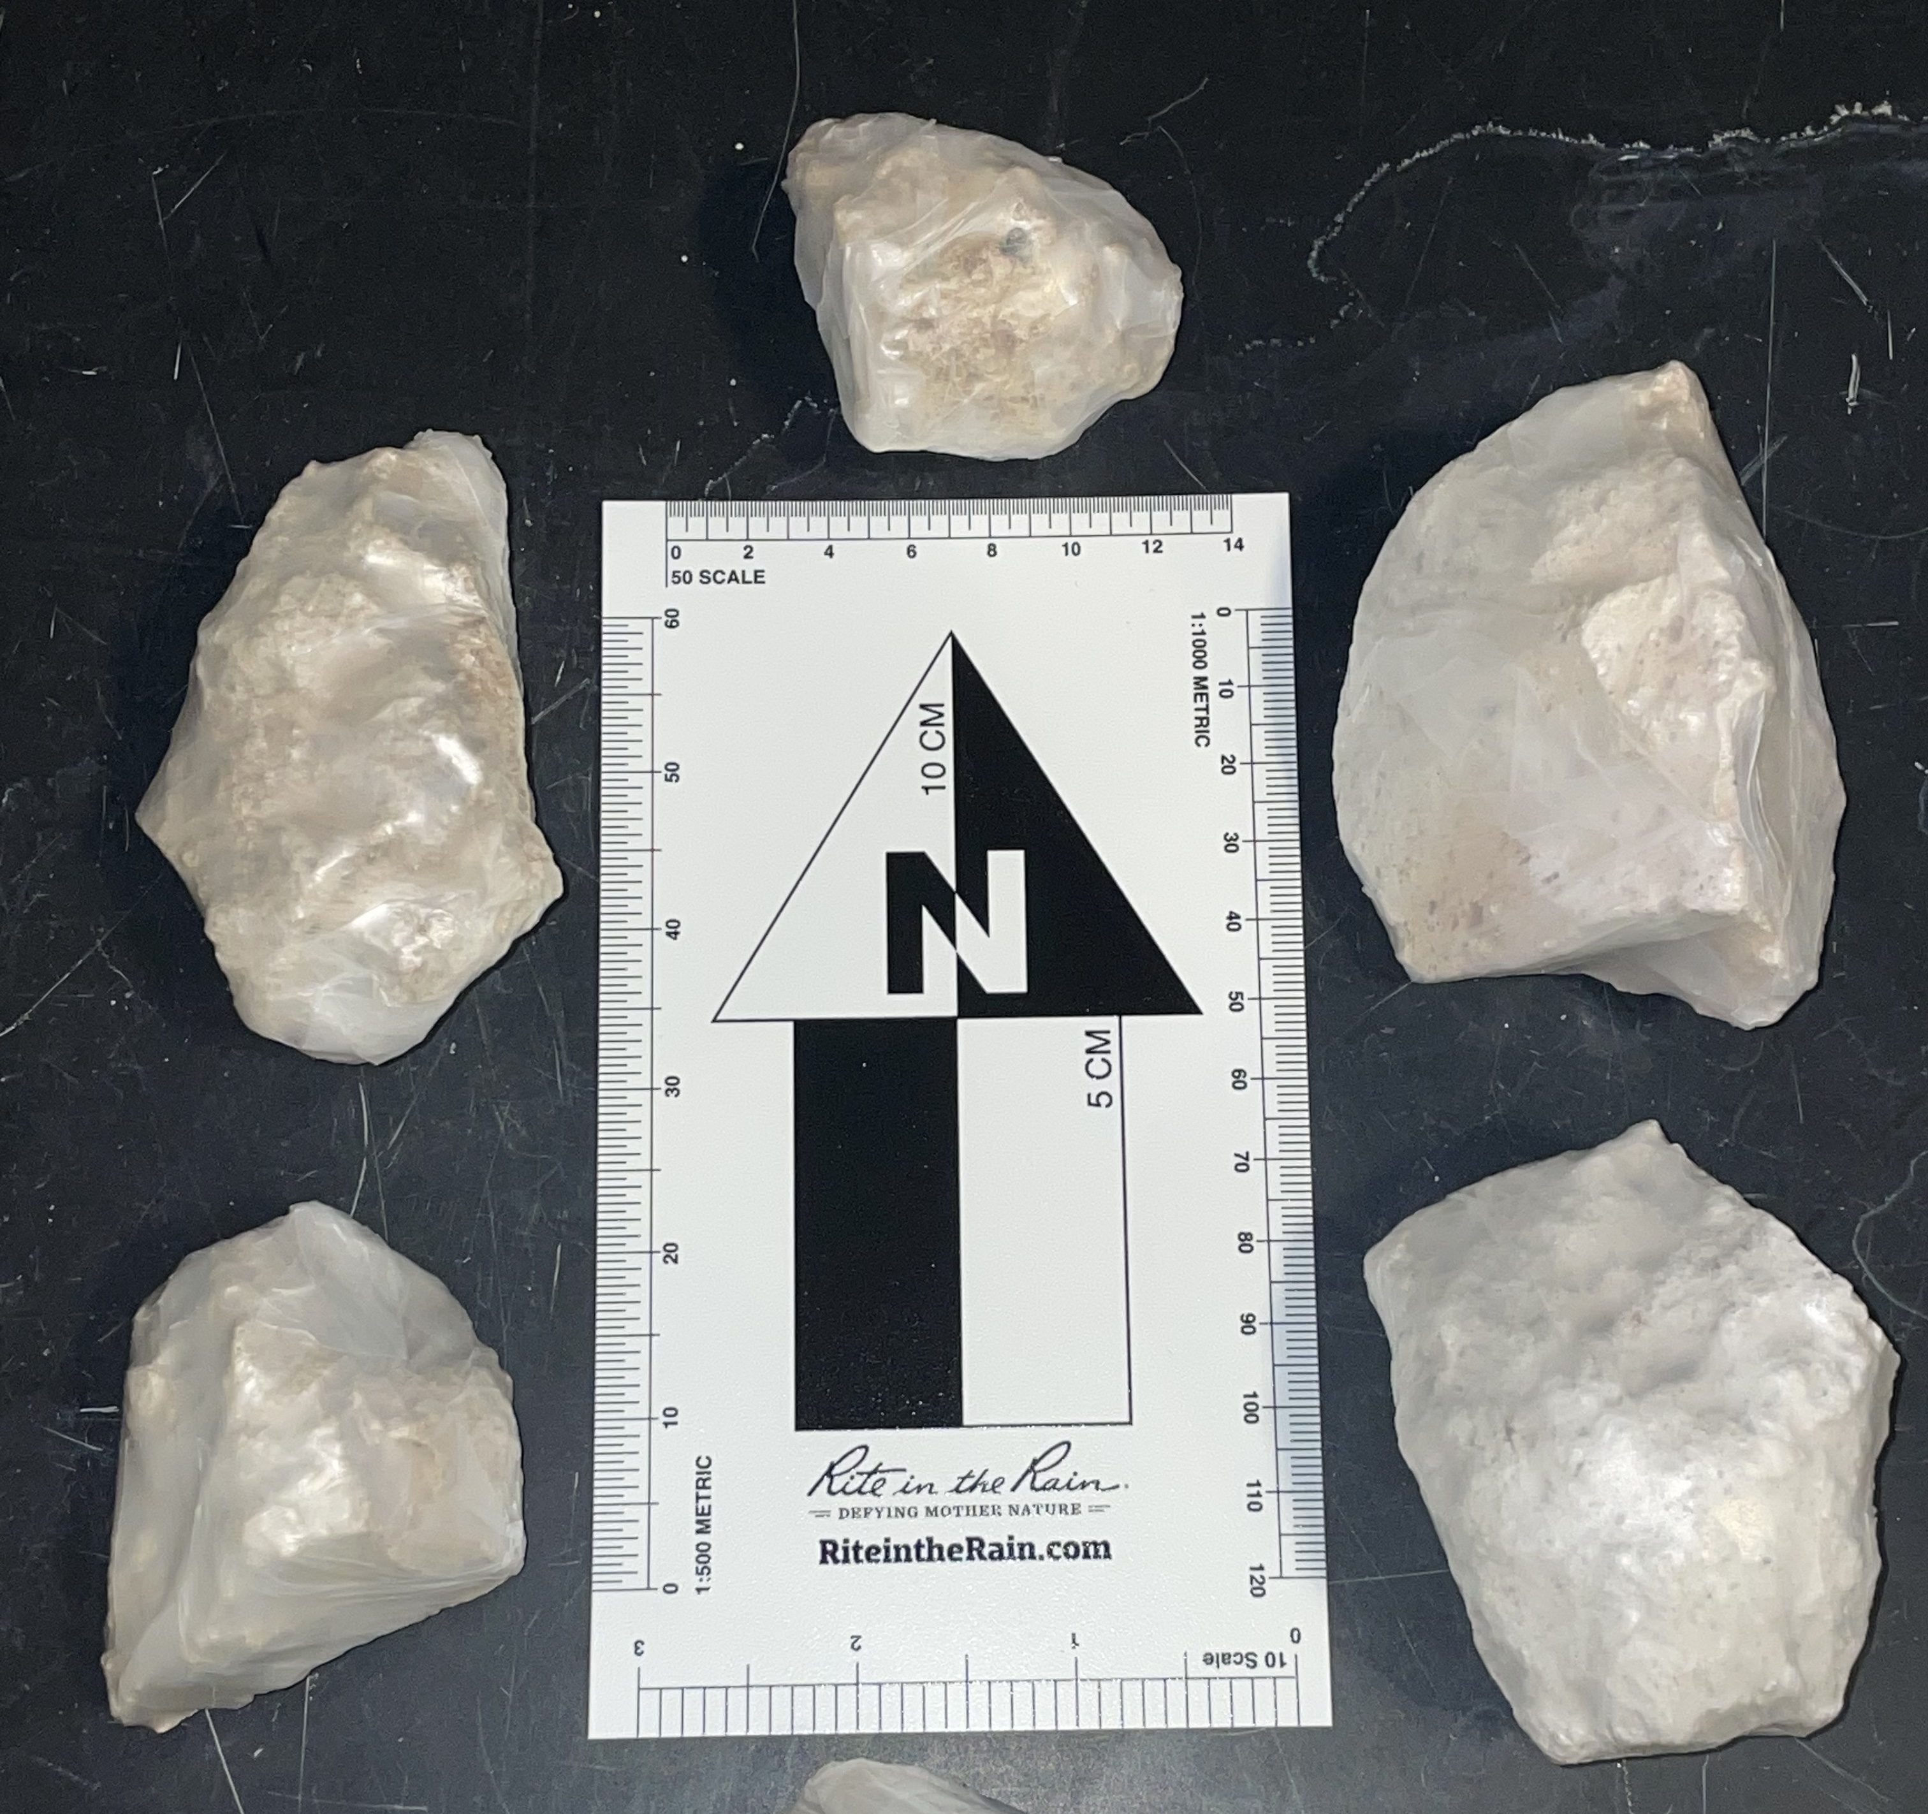
Samples
(Left) Representative pumice clasts showing different sizes and angularities. Note the similarity in texture and color of the clasts. (Right) Samples wrapped in parafilm.

Slide 9
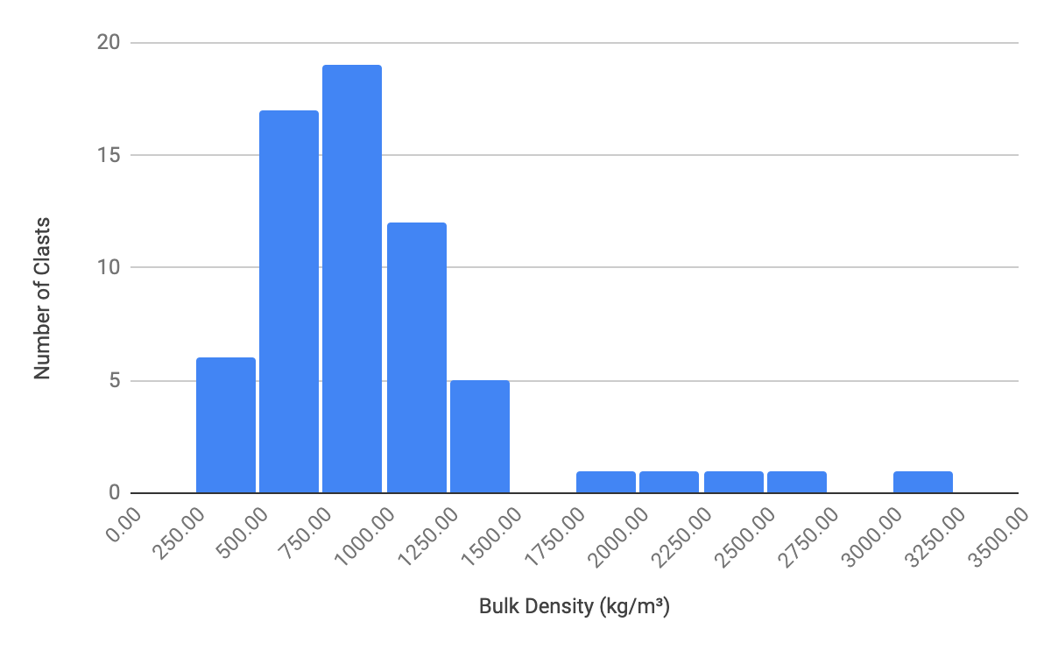
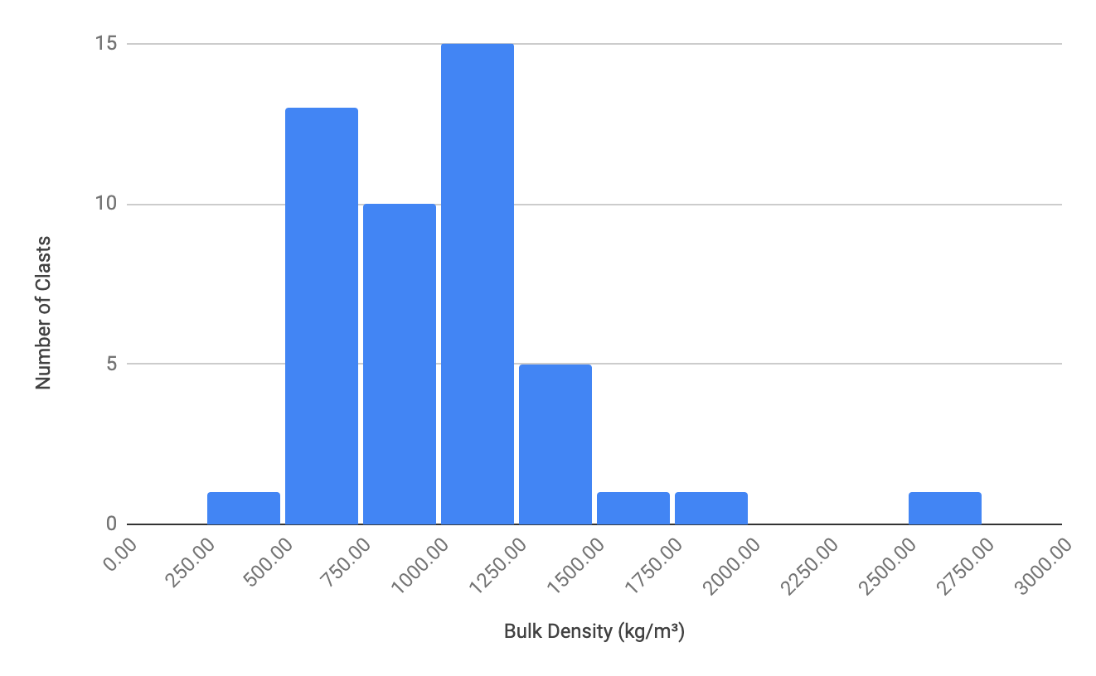
Data
Upper I unit
Histogram representing the densities. Top is the upper I unit and bottom is the lower I unit.
Peaks are the most populous. Five of the thin sections will come from the peaks and one from each of the tail bins.
Lower I unit

Slide 10
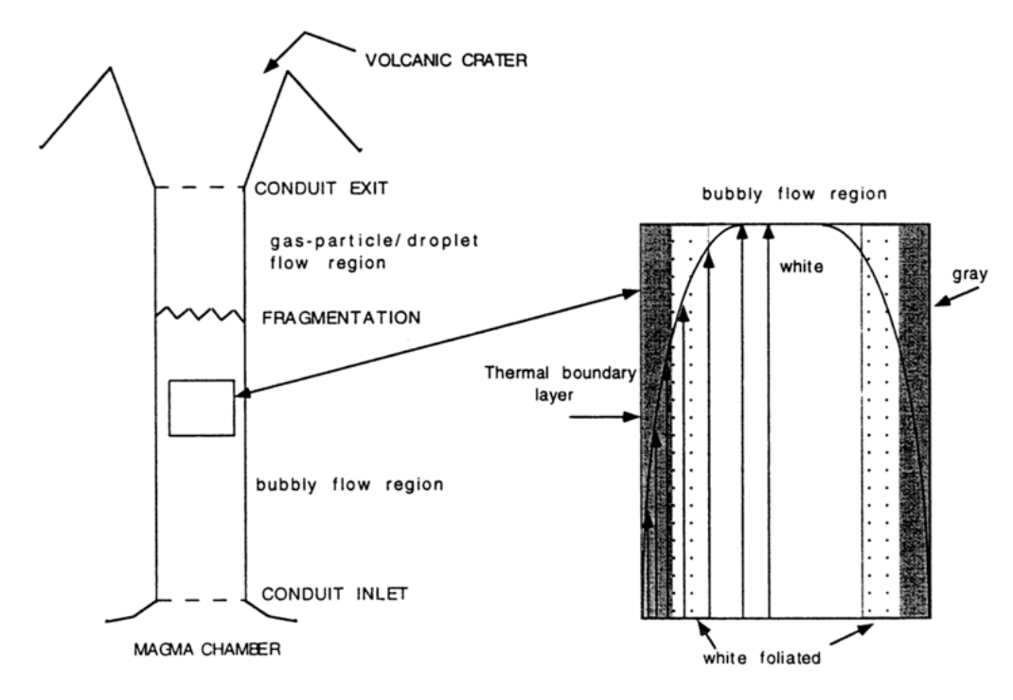


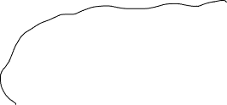


Discussion
Represents how vesiculated the magma was during the eruption.
  Key indicator in the amount of volcanic gas driving the eruption.
Upper unit appears to be slightly more gas rich.
Lower unit appears to have two peaks
Range in densities in a single unit may represent different degrees of bubble formation with depth in the volcanic conduit, or at different horizontal locations.
  Ex: Magma exploded from deep in the conduit may be denser than magma from shallower parts.
  Ex: Magma in the center is more vesiculated than magma along conduit walls
Illustration of the magma and how vesiculated it is in the conduit (Polacii et al, 2001)

Slide 11
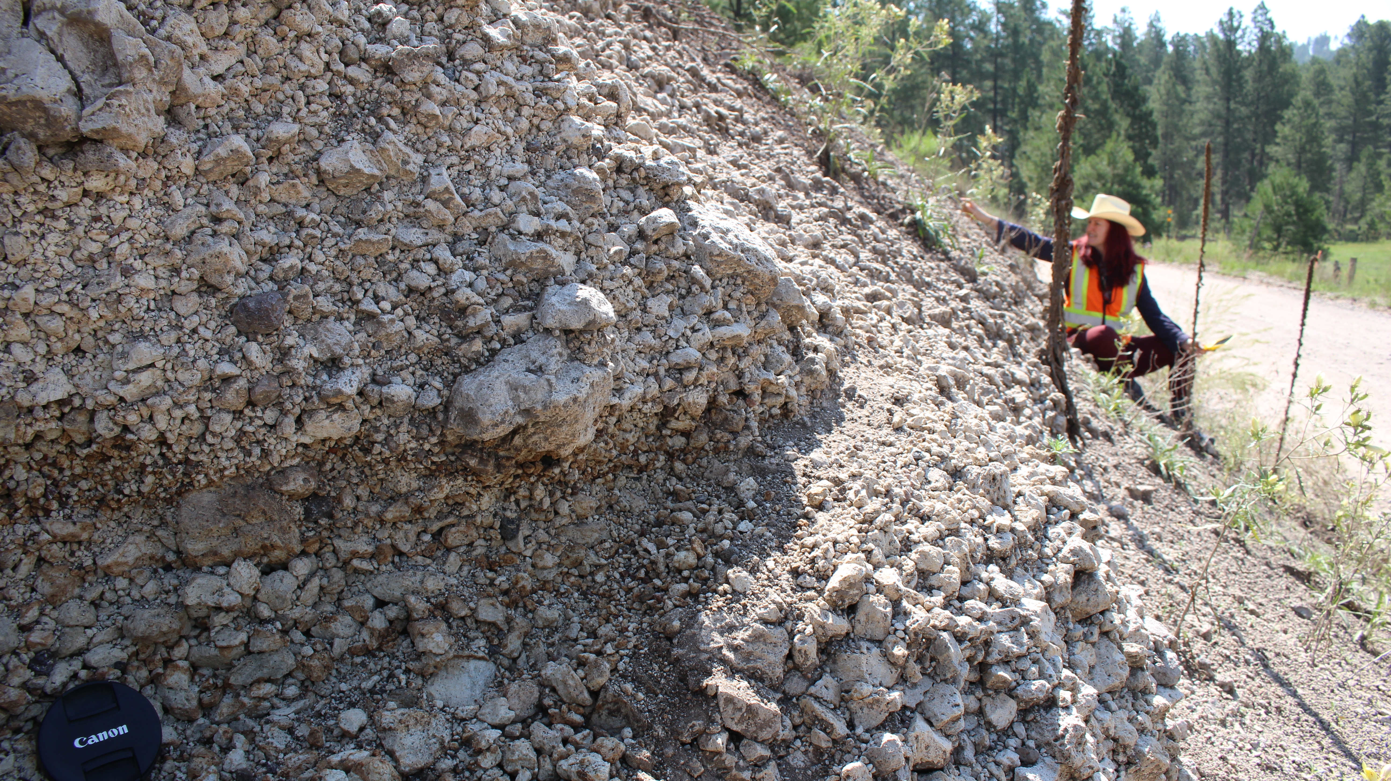
Future Work
Examine thin sections of pumice samples that represent a range of densities with a petrographic microscope and Scanning Electron Microscope (SEM).
Document the shape and distributions of crystals and bubbles to better understand the ascent conditions of magma.

Slide 12
Thank you
Any questions?

